Slide 1
Version control with Git
11.11.16

Slide 2
Automated Version Control
Questions
What is version control and why should I use it?
Objectives
Understand the benefits of an automated version control system
Understand the basics of how Git works

Slide 3
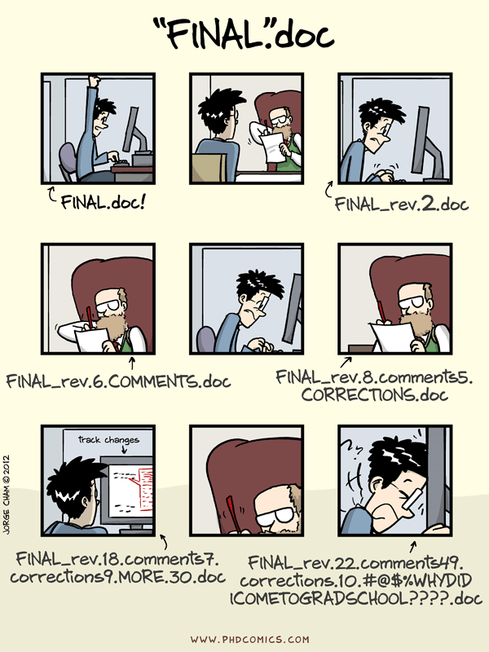
“Piled Higher and Deeper” by Jorge Cham, http://www.phdcomics.com

Slide 4
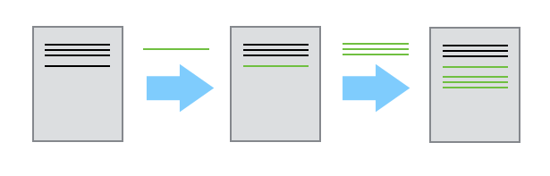
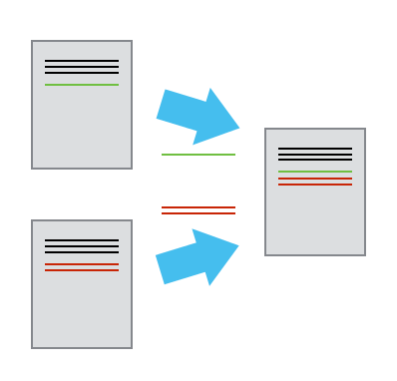
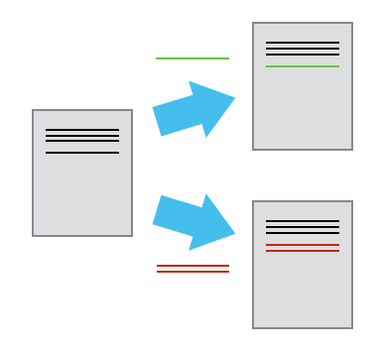

Slide 5
Automated Version Control
Exercises
Imagine you drafted an excellent paragraph for a paper you are writing, but later ruin it. How would you retrieve the excellent version of your conclusion? Is it even possible?
Imagine you have 5 co-authors. How would you manage the changes and comments they make to your paper? If you use LibreOffice Writer or Microsoft Word, what happens if you accept changes made using the Track Changes option? Do you have a history of those changes?

Slide 6
Setting Up Git
Questions
How do I get set up to use Git?
Objectives
Configure git the first time it is used on a computer.
Understand the meaning of the --global configuration flag.

Slide 7
Creating a Repository
Questions
Where does Git store information?
Objectives
Create a local Git repository.

Slide 8
Tracking Changes
Questions
How do I record changes in Git?
How do I check the status of my version control repository?
How do I record notes about what changes I made and why?
Objectives
Go through the modify-add-commit cycle for one or more files.
Explain where information is stored at each stage of Git commit workflow.

Slide 9
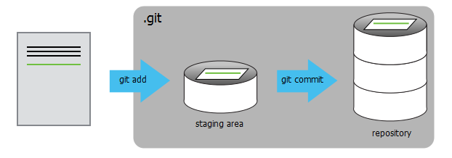

Slide 10
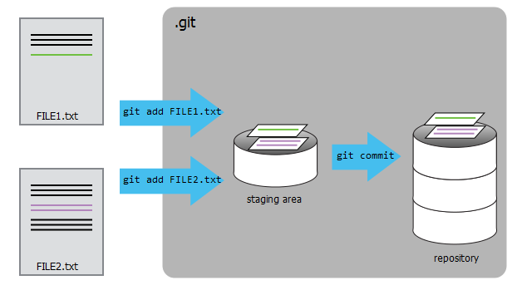

Slide 11
Tracking Changes
Exercises
Which of the following commit messages would be most appropriate for the last commit made to mars.txt?
“Changes”
“Added line ‘But the Mummy will appreciate the lack of humidity’ to mars.txt”
“Discuss effects of Mars’ climate on the Mummy”
Which command(s) below would save the changes of myfile.txt to my local Git repository?
$ git commit -m "my recent changes"
$ git init myfile.txt $ git commit -m "my recent changes"
$ git add myfile.txt $ git commit -m "my recent changes"
$ git commit -m myfile.txt "my recent changes“
The staging area can hold changes from any number of files that you want to commit as a single snapshot.
Add some text to mars.txt noting your decision to consider Venus as a base
Create a new file venus.txt with your initial thoughts about Venus as a base for you and your friends
Add changes from both files to the staging area, and commit those changes.

Slide 12
Exploring History
Questions
How can I identify old versions of files?
How do I review my changes?
How can I recover old versions of files?
Objectives
Explain what the HEAD of a repository is and how to use it.
Identify and use Git commit numbers.
Compare various versions of tracked files.
Restore old versions of files.

Slide 13
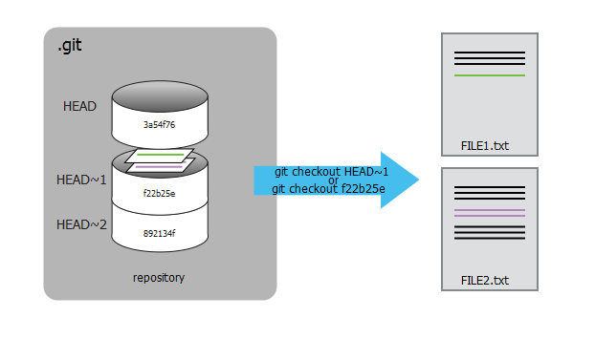

Slide 14
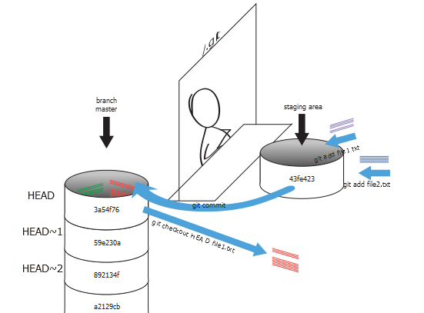

Slide 15
Exploring History
Exercises
What is the output of cat venus.txt at the end of this set of commands?
“Added line ‘But the Mummy will appreciate the lack of humidity’ to mars.txt”
“Discuss effects of Mars’ climate on the Mummy”
Which command(s) below would save the changes of myfile.txt to my local Git repository?
$ cd planets
$ nano venus.txt #input the following text: Venus is beautiful and full of love
$ git add venus.txt
$ nano venus.txt #add the following text: Venus is too hot to be suitable as a base
$ git commit -m "comments on Venus as an unsuitable base"
$ git checkout HEAD venus.txt
$ cat venus.txt #this will print the contents of venus.txt to the screen
git checkout can be used to restore a previous commit when unstaged changes have been made, but will it also work for changes that have been staged but not committed? Make a change to mars.txt, add that change, and use git checkout to see if you can remove your change.

Slide 16
Ignoring Things
Questions
How can I tell Git to ignore files I don’t want to track?
Objectives
Configure Git to ignore specific files.
Explain why ignoring files can be useful.

Slide 17
Remotes in GitHub
Questions
How do I share my changes with others on the web?
Objectives
Explain what remote repositories are and why they are useful.
Push to or pull from a remote repository.

Slide 18
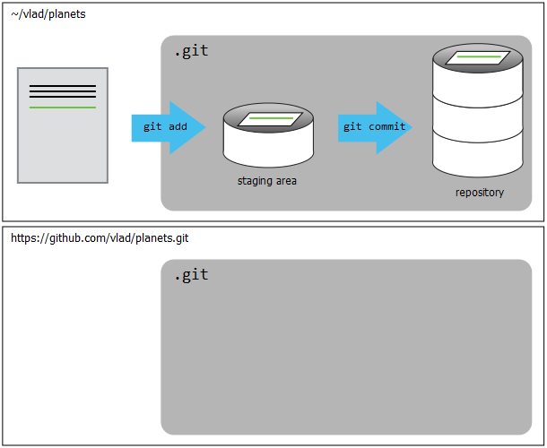

Slide 19
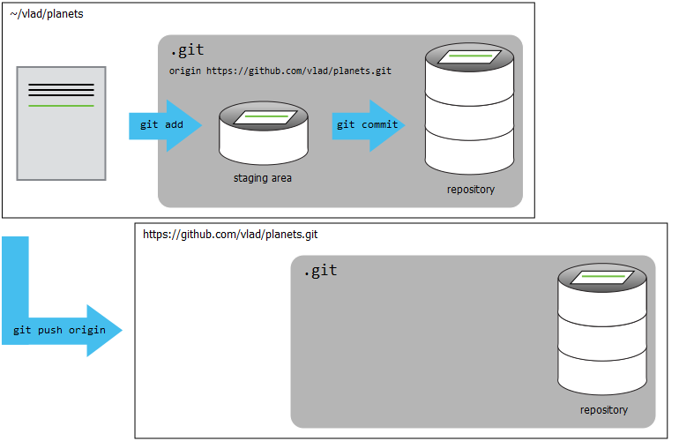

Slide 20
Remotes in GitHub
Exercises
In this lesson, we introduced the “git push” command. How is “git push” different from “git commit”?
Create a remote repository on GitHub. Push the contents of your local repository to the remote. Make changes to your local repository and push these changes. Go to the repo you just created on Github and check the timestamps of the files. How does GitHub record times, and why?

Slide 21
Collaborating
Questions
How can I use version control to collaborate with other people?
Objectives
Clone a remote repository.
Collaborate pushing to a common repository.

Slide 22
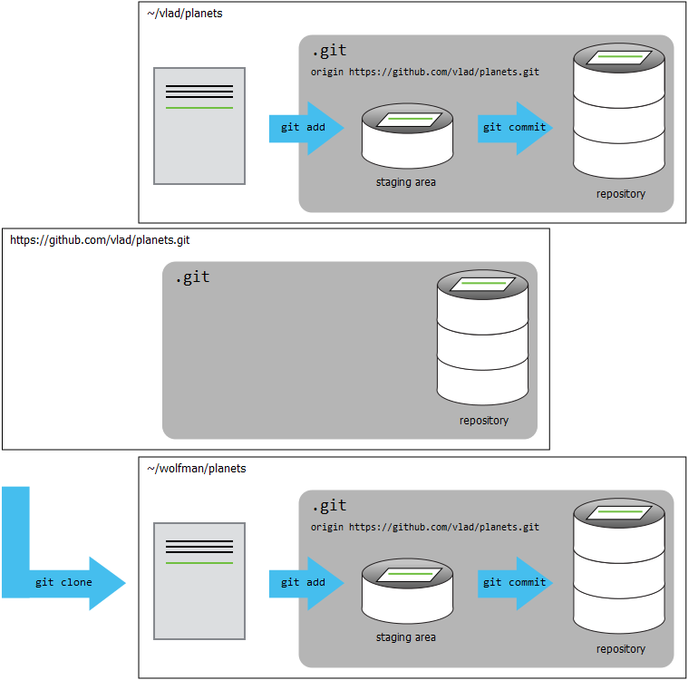

Slide 23
Conflicts
Questions
What do I do when my changes conflict with someone else’s?
Objectives
Explain what conflicts are and when they can occur.
Resolve conflicts resulting from a merge.

Slide 24
